Slide 1




Predicting Survival Time of LGG Patients: Refining Feature Selection Methods
Mackenzie M., Neo K., Rosie D., and Sanchayan B.

Slide 2
Goals
Compare different feature selection techniques to identify the one that yields the lowest Root Mean Squared Error (RMSE) in predicting survival time
Develop a model that can be effectively generalized to newer data, mitigating the risk of overfitting and ensuring robust performance
Address multicollinearity issues in the dataset by implementing appropriate methods to manage and control the impact of highly correlated predictor variables

Slide 3
Pipeline of Project
Data
Feature Selection
Transformation
Linear Model
Tests
Genomics
Imaging
Random Forests
Box-Cox
Ridge Regression
RMSE
Diagnostic Plots
Boruta
LM
Bagged Trees
Stability Selection
Robustness
LASSO

Slide 4
Pipeline of Project
Data
Feature Selection
Transformation
Linear Model
Tests
Genomics
Imaging
Random Forests
Box-Cox
Ridge Regression
RMSE
Diagnostic Plots
Boruta
LM
Bagged Trees
Stability Selection
Robustness
LASSO

Slide 5
Splitting Data
Train Data
Data
Test Data

Slide 6
Pipeline of Project
Data
Feature Selection
Transformation
Linear Model
Tests
Genomics
Imaging
Random Forests
Box-Cox
Ridge Regression
RMSE
Diagnostic Plots
Boruta
LM
Bagged Trees
Stability Selection
Robustness
LASSO

Slide 7
Feature Selection Methods
LASSO
Recursive Feature Elimination
Random Forests
LM
Bagged Trees
Boruta

Slide 8
Feature Selection Methods
LASSO
Recursive Feature Elimination
Random Forests
LM
Bagged Trees
Boruta
Linear regression method that adds penalty term to the loss function to encourage sparsity, resulting in feature selection and regularization

Slide 9
Feature Selection Methods
LASSO
Recursive Feature Elimination
Random Forests
LM
Bagged Trees
Boruta
Identifies important variables by comparing importance of original features with that of shadow variables, facilitating robust and accurate model building

Slide 10
Feature Selection Methods
Recursive Feature Elimination
Random Forests
LM
Bagged Trees
Recursively removes less important features from a model to improve its performance and reduce overfitting

Slide 11
Feature Selection Methods
Recursive Feature Elimination
Random Forests
LM
Bagged Trees
Recursively removes less important features from a model to improve its performance and reduce overfitting
Removes features that increase mean error of Random Forest regressor
Orders according to magnitude of coefficients of features
Removes features that increase mean error of the Bagging

Slide 12
Pipeline of Project
Data
Feature Selection
Transformation
Linear Model
Tests
Genomics
Imaging
Random Forests
Box-Cox
Ridge Regression
RMSE
Diagnostic Plots
Boruta
LM
Bagged Trees
Stability Selection
Robustness
LASSO

Slide 13
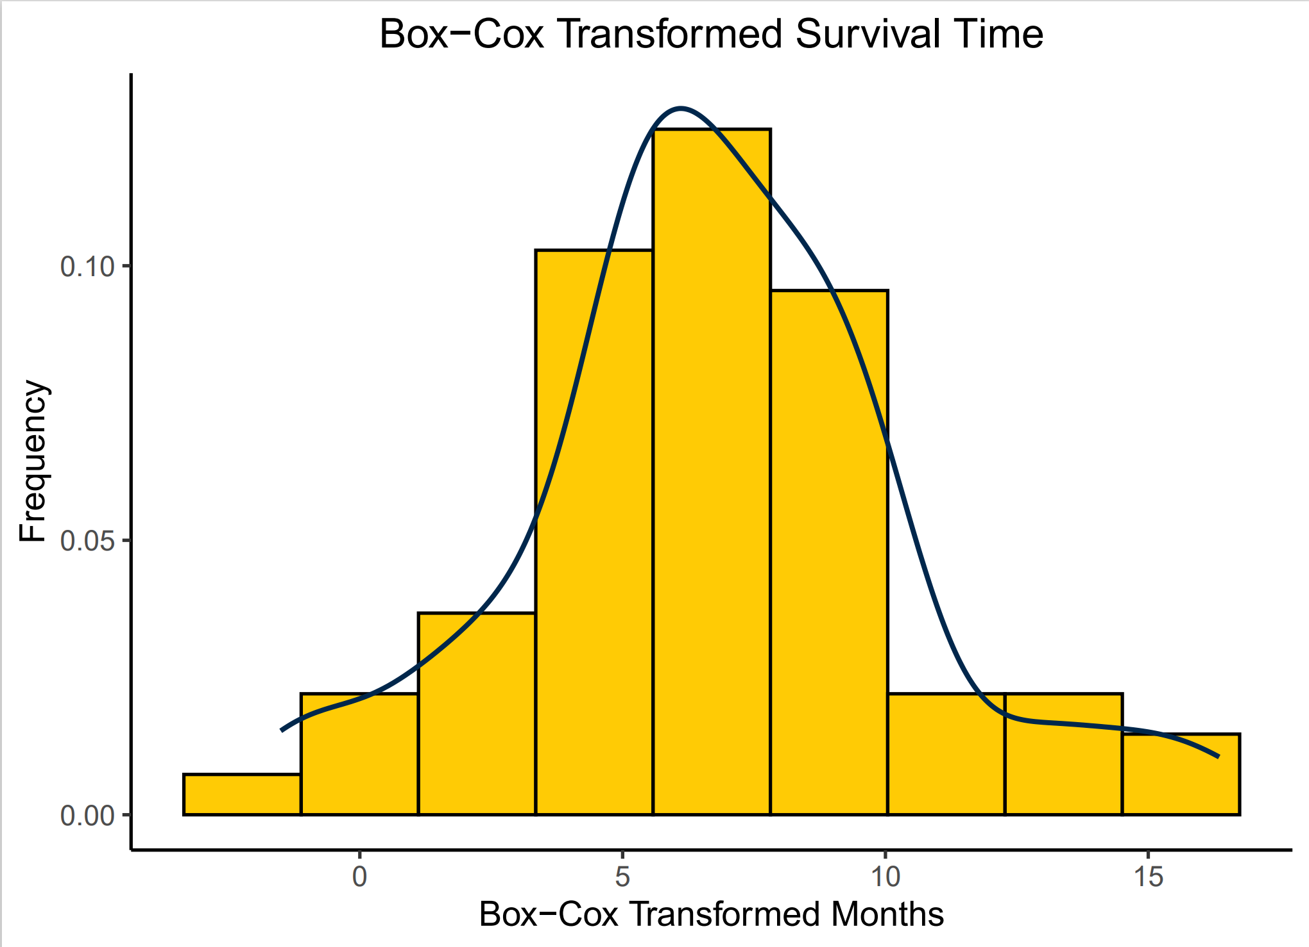
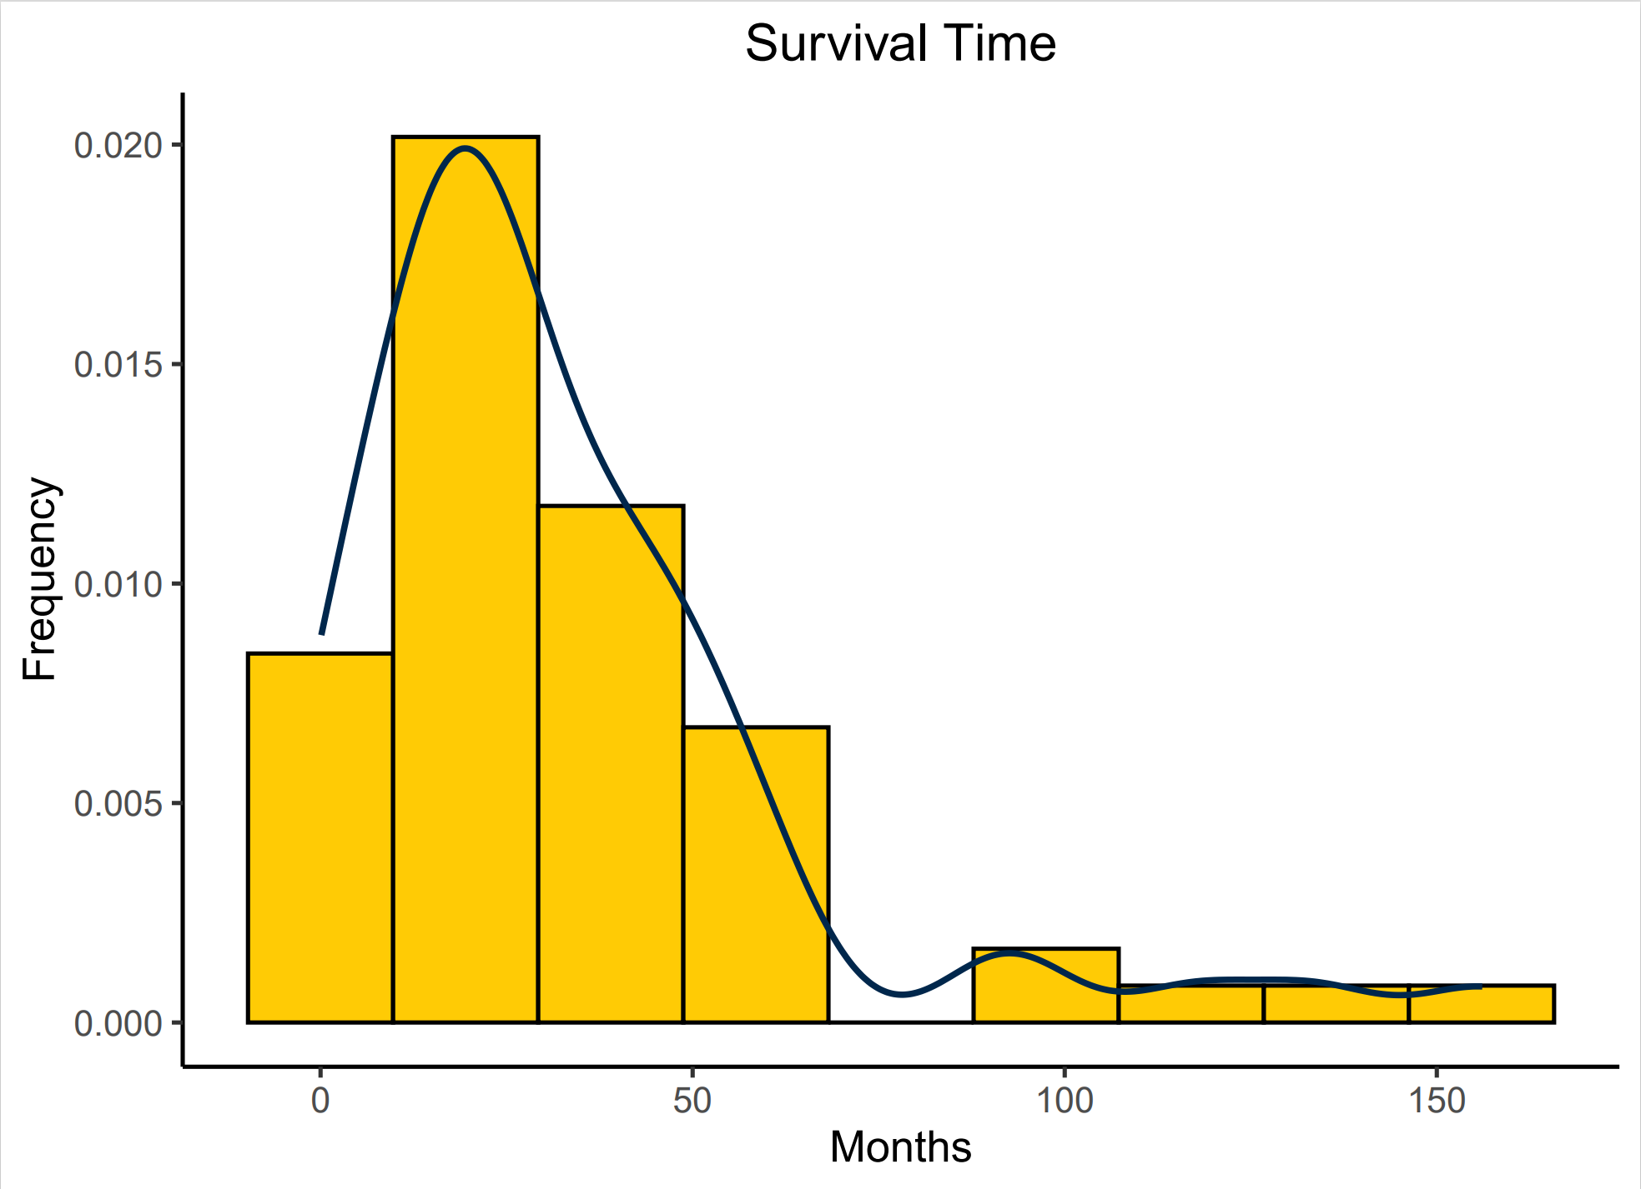
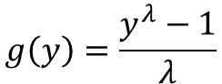
Survival Time Transformation
$$g\left(y\right)=\frac{y^{λ}−1}{λ}$$

Slide 14
Pipeline of Project
Data
Feature Selection
Transformation
Linear Model
Tests
Genomics
Imaging
Random Forests
Box-Cox
Ridge Regression
RMSE
Diagnostic Plots
Boruta
LM
Bagged Trees
Stability Selection
Robustness
LASSO

Slide 15
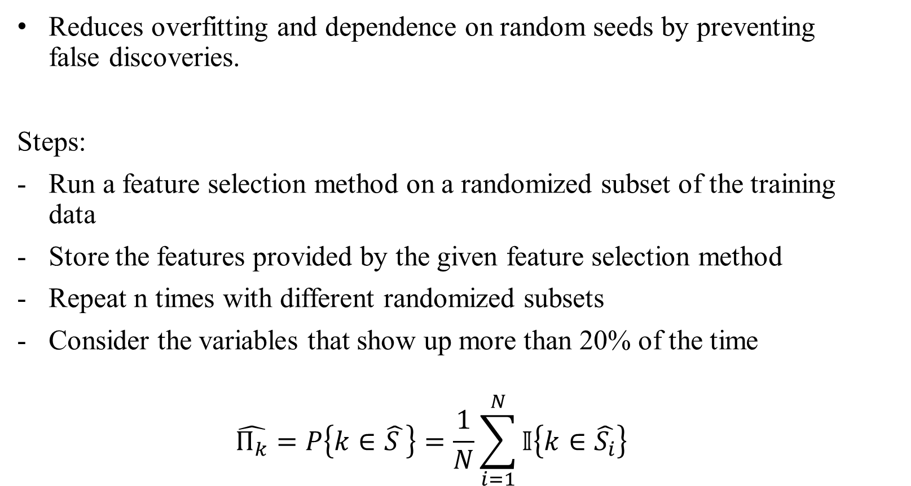
Stability Selection
Reduces overfitting and dependence on random seeds by preventing false discoveries.
Steps:
Run a feature selection method on a randomized subset of the training data
Store the features provided by the given feature selection method
Repeat n times with different randomized subsets
Consider the variables that show up more than 20% of the time
$$\hat{Π_{k}}=P\left\{k∈\hat{S }\right\}=\frac{1}{N}\sum_{i=1}^{N}{𝕀\left\{k∈\hat{S_{i}}\right\}}$$

Slide 16
Stability Selection

Slide 17
Stability Selection
Feature selection method is applied to this part of data.

Slide 18
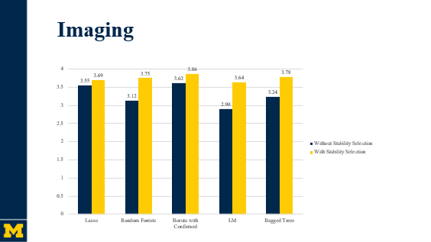
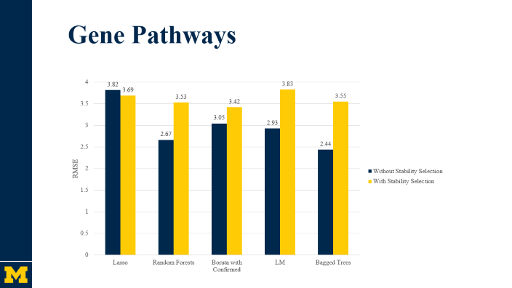
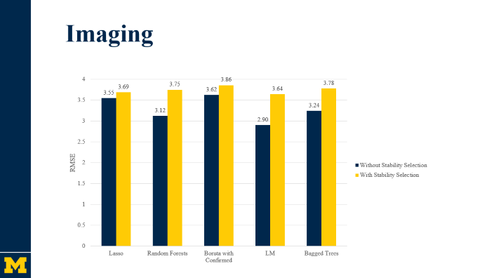
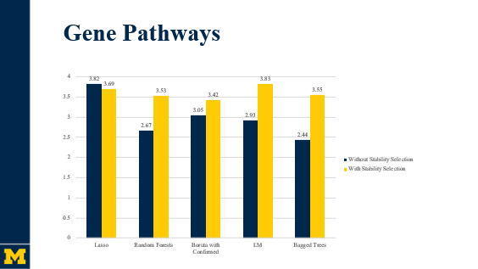
Effect of Stability Selection

Slide 19
Gene Pathways

Slide 20
Gene Pathways
Notes:
According to paper, bagged tree shouldn’t perform better than rf

Slide 21
Imaging

Slide 22
Pipeline of Project
Data
Feature Selection
Transformation
Linear Model
Tests
Genomics
Imaging
Random Forests
Box-Cox
Ridge Regression
RMSE
Diagnostic Plots
Boruta
LM
Bagged Trees
Stability Selection
Robustness
LASSO

Slide 23
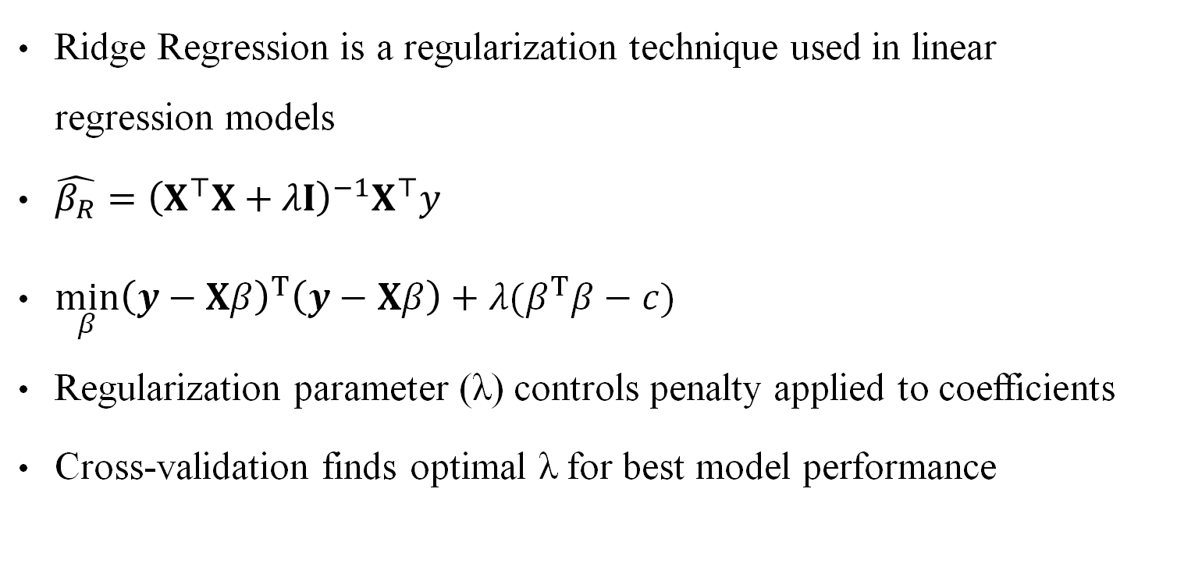
Ridge Regression
Ridge Regression is a regularization technique used in linear regression models
$\hat{β_{R}}={\left(X^{⊤}X+λI\right)}^{−1}X^{⊤}y$
$\min_{β}{\left(y−Xβ\right)}^{T}\left(y−Xβ\right)+λ(β^{T}β−c)$
Regularization parameter (λ) controls penalty applied to coefficients
Cross-validation finds optimal λ for best model performance

Slide 24
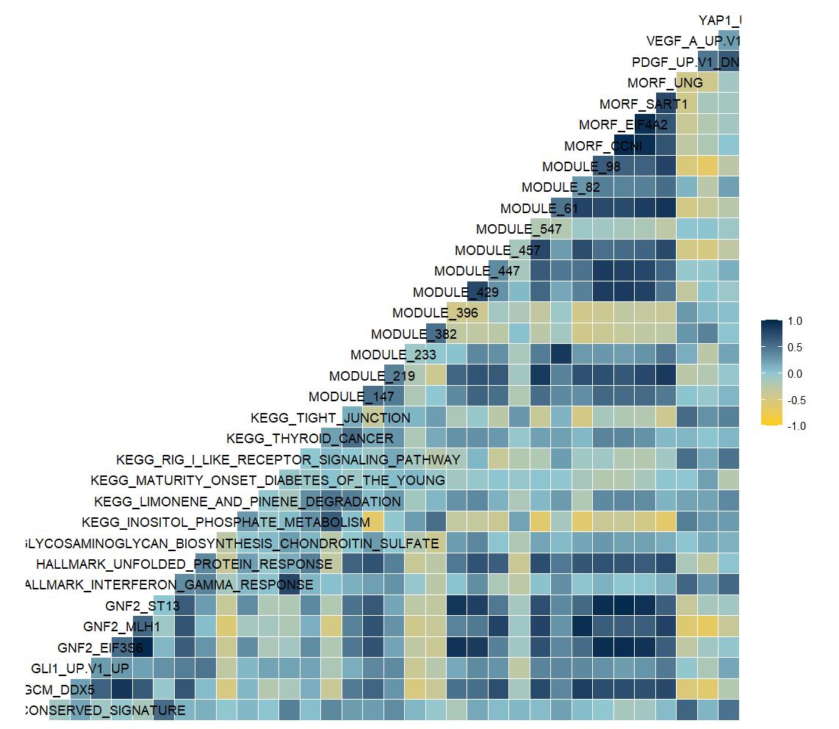
Why Ridge?
Reduces impact of multicollinearity on model
Prevents over-fitting

Slide 25
Pipeline of Project
Data
Feature Selection
Transformation
Linear Model
Tests
Genomics
Imaging
Random Forests
Box-Cox
Ridge Regression
RMSE
Diagnostic Plots
Boruta
LM
Bagged Trees
Stability Selection
Robustness
LASSO

Slide 26
RMSE of Feature Selection Methods

Slide 27
RMSE of Feature Selection Methods

Slide 28
RMSE of Feature Selection Methods

Slide 29
RMSE of Feature Selection Methods
3.8

Slide 30

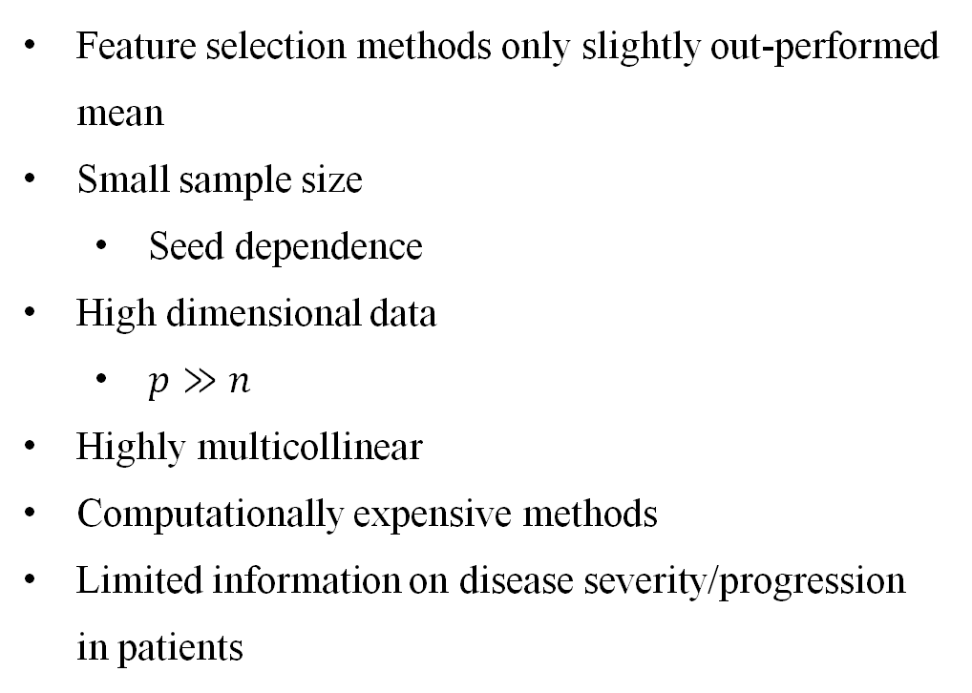
Limitations
Feature selection methods only slightly out-performed mean
Small sample size
Seed dependence
High dimensional data
$p≫n$
Highly multicollinear
Computationally expensive methods
Limited information on disease severity/progression in patients

Slide 31

Key Takeaways
Boruta method with genomic data performed best overall
RMSE of 3.42
LASSO is very consistent
0.07 RMSE difference between genomic and imaging models
0.13 RMSE difference between pre-and post-stability models
Stability selection effectively ensures reliability and robustness
Reduces the impact of dependency on randomness, especially for low n
High dimensional data is very difficult to work with

Slide 32
References
Breiman, L. (1996). Bagging predictors. Machine learning, 24, 123-140.
Breiman, L. (2001). Random forests. Machine learning, 45, 5-32.
Huang, S., & Marchetti-Bowick, M. (2014). Summary and discussion of: “Stability Selection” Statistics Journal Club, 36-825.
Liaw, A., & Wiener, M. (2002). Classification and regression by random forest. R news, 2(3), 18-22.
Meinshausen, N., & Bühlmann, P. (2010). Stability selection. Journal of the Royal Statistical Society Series B: Statistical Methodology, 72(4), 417-473.
Kursa, M. B., & Rudnicki, W. R. (2010). Feature Selection with the Boruta Package. Journal of Statistical Software, 36(11), 1–13. https://doi.org/10.18637/jss.v036.i11

